Slide 1

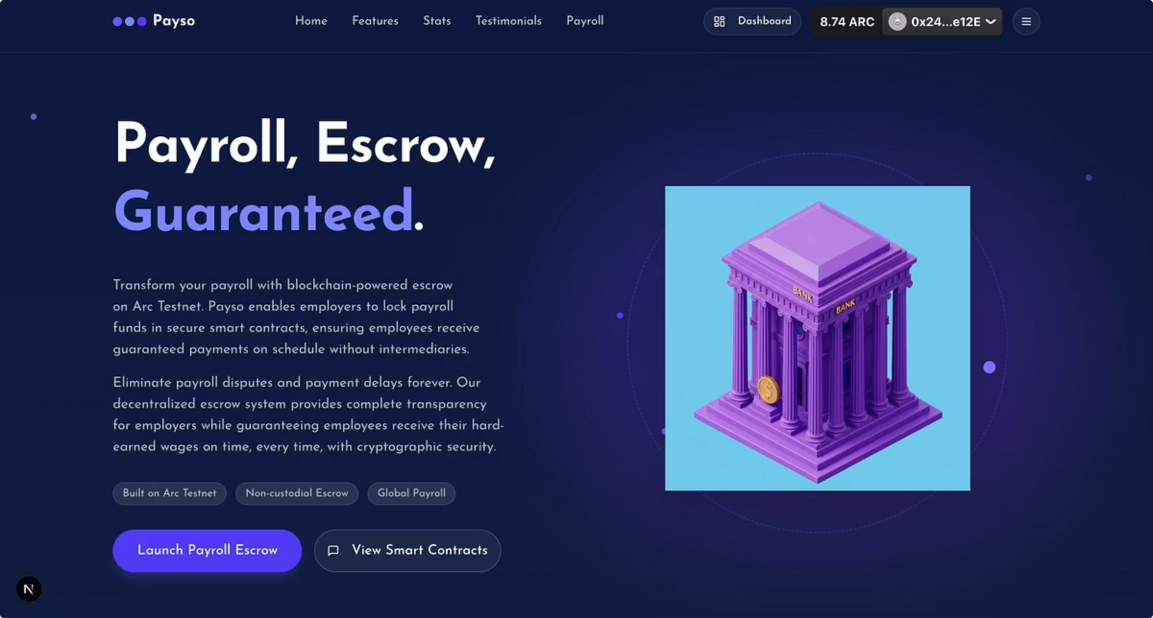
Payso
Blockchain-Powered Payroll Escrow for the
Modern Workforce
Automated, Secure, Transparent Salary Payments
on Arc Testnet

Slide 2

The Problem We're Solving
Traditional Payroll Problems
Payso Solutions
Automated time-locked payments
Payment delays and disputes
High international transfer fees (3-7%)
Low blockchain transaction fees
Lack of transparency
Complete transparency on blockchain
Manual verification processes
Currency conversion complications
Smart contract automation
Built-in USDC ↔ EURC conversion
Trust issues between parties
Trustless escrow system

Slide 3




How Payso Works
Employer Schedules Payment
Deposits USDC/EURC into smart contract, sets release date and amount, chooses employee's preferred payout currency.
Smart Contract Holds Funds
Funds locked in escrow until release date. Immutable and transparent. Automatic FX conversion if needed.
Employee Claims Payment
Payment becomes claimable on release date. Employee claims with one click. Instant settlement in preferred currency.

Slide 4




Key Features & Technology
Smart Contract Escrow
Dual Dashboard System
Time-locked payments with guaranteed release
Employer: Schedule payments, manage employees
Multi-currency support (USDC & EURC)
Employee: View payments, claim funds
Optional work verification system
Real-time blockchain updates
Automatic FX conversion via FXRouter
Enterprise-Grade Security
Advanced Financial Features
Multi-layer validation (client, server, blockchain)
Flexible payout options (USDC ↔ EURC)
Double confirmation for all payments
Complete transaction history
Rate limiting and XSS prevention
Automatic currency conversion
OWASP security compliance
Low transaction fees on Arc Testnet

Slide 5





Technology Stack & Architecture
Frontend
Next.js 16 with App Router & Turbopack, React 19, TypeScript, Tailwind CSS, Radix UI, Web3 integration (Wagmi v2, Viem v2, RainbowKit v2)
Smart Contracts
PayrollEscrow.sol (main escrow logic), FXRouter.sol (USDC ↔ EURC conversion), MockStablecoin.sol (ERC20 testing), built with Foundry
Blockchain Infrastructure
Arc Testnet (Chain ID: 5042002), USDC as native gas token, block explorer integration, fast transaction finality
Backend & APIs
Payment validation API with rate limiting, transaction history API, real-time blockchain event monitoring, comprehensive error handling

Slide 6
User Experience
Employer Journey
Employee Journey
Connect wallet (MetaMask/WalletConnect)
Connect wallet
View dashboard with payment stats
View all scheduled payments
Schedule payment: enter details, set date
See countdown to release date
Double confirmation dialogue
Claim payment when available
Transaction submitted to blockchain
Automatic currency conversion
Track payment in real-time
Funds received instantly
Beautiful, modern interface
Fully responsive (mobile-friendly)
Real-time notifications
Transaction history with filters
Block explorer integration

Slide 7
Impact & Use Cases
Global Remote Teams
Freelance & Gig Economy
Traditional Companies Going Crypto
Pay developers, designers, marketers worldwide. No bank accounts needed. Eliminate international transfer fees. Instant settlement in preferred currency.
Milestone-based payments with work verification. Escrow protects both parties. Automatic release on completion. Build trust with new clients.
Transition to blockchain payroll gradually. Reduce payroll processing costs by 80%. Eliminate payment disputes. Complete audit trail on blockchain.
$600B
25%
40%
10K+
Global Payroll Market
Remote Work Annual Growth
Crypto Payments CAGR
Target Companies Year 1

Slide 8

What's Next
1
Current - Production Ready
Fully functional smart contracts on Arc Testnet, production-ready frontend with dual dashboards, enterprise-grade security, real-time tracking, automatic currency conversion.
2
Phase 1 - Q1 2025
Email/SMS notifications for payment events, advanced analytics dashboard, PDF invoice generation, multi-signature wallet support.
3
Phase 2 - Q2 2025
Mainnet deployment on Arc, business account features, mobile app (iOS & Android), integration with accounting software (QuickBooks, Xero).
4
Phase 3 - Q3 2025
Fiat on/off ramps, payroll card integration, multi-chain support, AI-powered payroll optimisation.

Slide 9

Ready to Transfer Global Payroll
Payso is production-ready today. Experience the future of automated, secure, transparent salary payments on Arc Testnet.
Try It Now
View on GitHub
Visit our demo and connect your wallet to experience Payso
Explore the full source code and documentation
Get in Touch
Interested in partnering or investing? Reach out today
Thank you. Payso is ready to transform global payroll, and we're excited to have Arc Testnet as our foundation.

